Slide 1
ARTIFICIAL INTELLIGENCE

Slide 2
CATEGORIES OF AI
THINKING HUMANLY Automation of activities through use of human thinking ( Eg Decision making, problem solving, learning ) | SYSTEMS THAT THINK RATIONALLY Study of mental faculties through use of computational models
SYSTEMS THAT ACT LIKE HUMANS Art of creating machines that perform functions that require intelligence when performed by people | SYSTEMS THAT ACT RATIONALLY Computational Intelligence – Study of design of intelligent agents

Slide 3
CONCEPTS
Rational Agent
Learning
Background Knowledge
Acquired Knowledge
Autonomy
Percepts
Omniscient

Slide 4
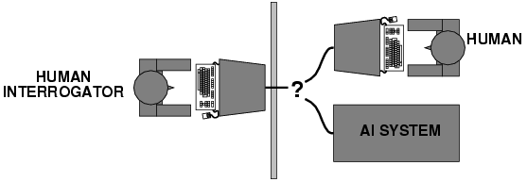
TURING TEST
Turing (1950) "Computing machinery and intelligence":
"Can machines think?" → "Can machines behave intelligently?"
Operational test for intelligent behavior: the Imitation Game
Predicted that by 2000, a machine might have a 30% chance of fooling a lay person for 5 minutes
Anticipated all major arguments against AI in following 50 years
Suggested major components of AI: knowledge, reasoning, language understanding, learning
For total Turing test, include subject’s perceptual abilities

Slide 5
COMPONENTS
Natural Language Processing
Enable it to communicate successfully in English
Knowledge Representation
Store what one knows / hears
Automated reasoning
Use stored information to answer questions / draw new conclusions
Machine Learning
Adopt new circumstances to detect and extrapolate patterns
For total Turing test, computer needs computer vision for perceiving objects and robots to manipulate objects and move around.
Turing test is not reproducible , constructive or amenable to mathematical analysis

Slide 6
Thinking humanly: cognitive modeling
1960s "cognitive revolution": information-processing psychology
Requires scientific theories of internal activities of the brain
How to validate?
Requires predicting and testing behavior of human subjects (top-down)
Direct identification from neurological data (bottom-up)
Both approaches (roughly, Cognitive Science and Cognitive Neuroscience) are now distinct from AI
Both share with AI the following characteristic: the available theories do not explain ( or engender) anything resembling human-level general intelligence

Slide 7
Thinking rationally: "laws of thought"
Aristotle: what are correct arguments/thought processes?
Several Greek schools developed various forms of logic: notation and rules of derivation for thoughts; may or may not have proceeded to the idea of mechanization
Direct line through mathematics and philosophy to modern AI
Problems:
Not all intelligent behavior is mediated by logical deliberation
What is the purpose of thinking? What thoughts should I have?

Slide 8
Acting rationally: rational agent
Rational behavior: doing the right thing
The right thing: that which is expected to maximize goal achievement, given the available information
Doesn't necessarily involve thinking – e.g., blinking reflex – but thinking should be in the service of rational action

Slide 9
Rational agents
An agent is an entity that perceives and acts
This course is about designing rational agents
Abstractly, an agent is a function from percept histories to actions:
[f: P* → A]
For any given class of environments and tasks, we seek the agent (or class of agents) with the best performance
Caveat: computational limitations make perfect rationality unachievable
Design best program for given machine resources

Slide 10
AI prehistory
Philosophy Logic, methods of reasoning, mind as physical system foundations of learning, language, rationality
Mathematics Formal representation and proof algorithms, computation, (un)decidability, (in)tractability, probability
Economics utility, decision theory
Neuroscience physical substrate for mental activity
Psychology phenomena of perception and motor control, experimental techniques
Computer building fast computers engineering
Control theory design systems that maximize an objective function over time
Linguistics knowledge representation, grammar

Slide 11
HISTORY of AI
1943 McCulloch & Pitts: Boolean circuit model of brain
1950 Turing's "Computing Machinery and Intelligence"
1956 Dartmouth meeting: "Artificial Intelligence" adopted
1952—69 Look, Ma, no hands!
1950s Early AI programs, including Samuel's checkers program, Newell & Simon's Logic Theorist, Gelernter's Geometry Engine
1965 Robinson's complete algorithm for logical reasoning
1966—73 AI discovers computational complexity Neural network research almost disappears
1969—79 Early development of knowledge-based systems
1980-- AI becomes an industry
1986-- Neural networks return to popularity
1987-- AI becomes a science
1995-- The emergence of intelligent agents

Slide 12
AGENTS AND ENVIRONMENTS
Agents include humans, robots, softbots, thermostats, etc.
The agent function maps from percept histories to actions:
f : P* → A
The agent program runs on the physical architecture to produce f

Slide 13
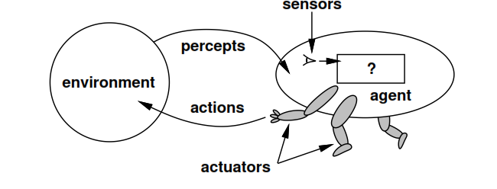
RELATIONSHIP BETWEEN AGENT AND ENVIRONMENT

Slide 14
CONCEPTS
Percept Sequence
Complete history of whatever agent has perceived
Agent Function
Maps percept sequence to an action
Agent program
Concrete implementation running on agent architecture
Vaccuum Cleaner – Example : Explanation

Slide 15
RATIONALITY
Depends on
Performance measure that defines criteria of success
Agent’s prior knowledge of environment
Actions that agent can perform
Agent’s percept sequence to date

Slide 16
AGENT PROGRAMS/ TYPES
Simple Reflex agents
Reflex agents with state
Goal-based agents
Utility based agents
All these can be turned into learning agents

Slide 17
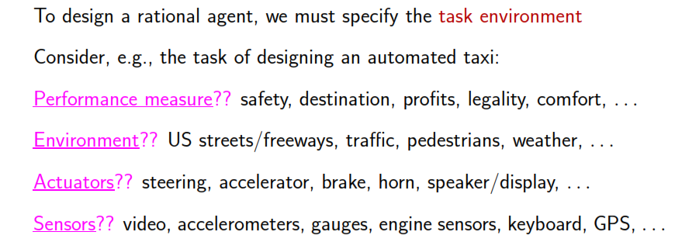
PEAS

Slide 18
ENVIRONMENT TYPES
OBSERVABILITY
DETERMINISTIC
EPISODIC
STATIC
DISCRETE
SINGLE / MULTI AGENT

Slide 19
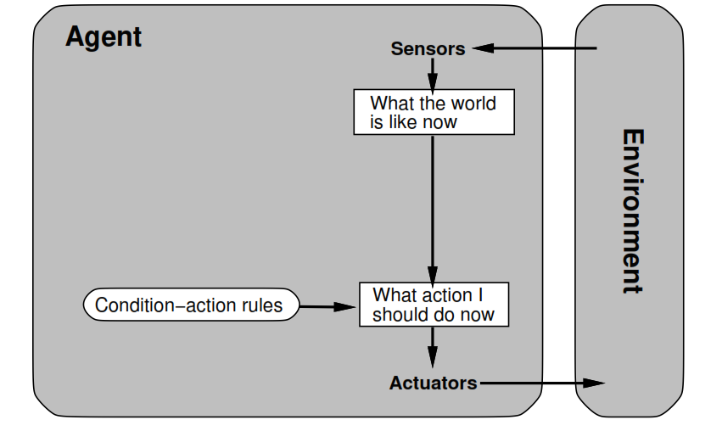
SIMPLE REFLEX AGENTS

Slide 20
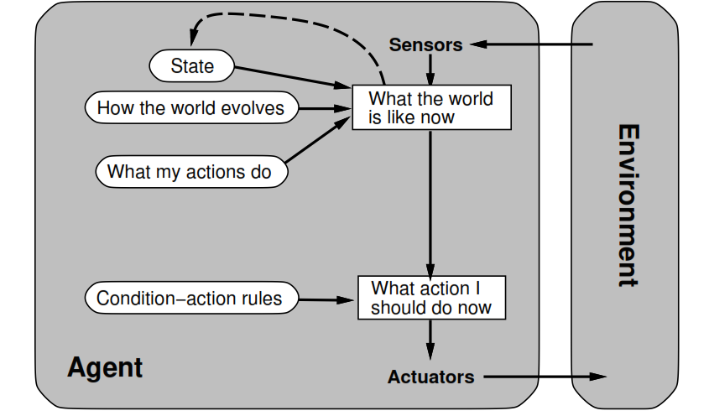
MODEL BASED REFLEX AGENTS

Slide 21
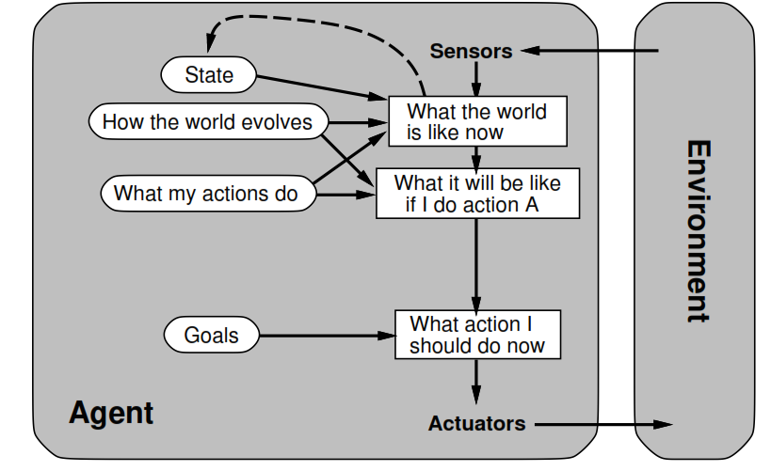
GOAL BASED REFLEX AGENTS

Slide 22
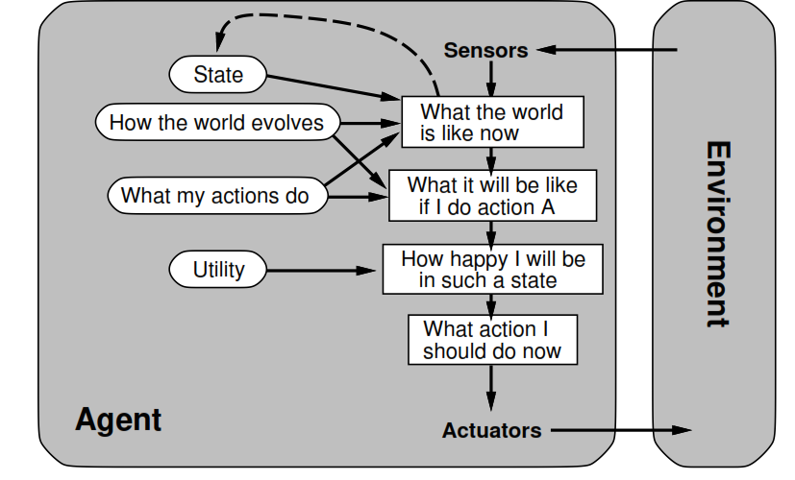
UTILITY BASED AGENTS

Slide 23
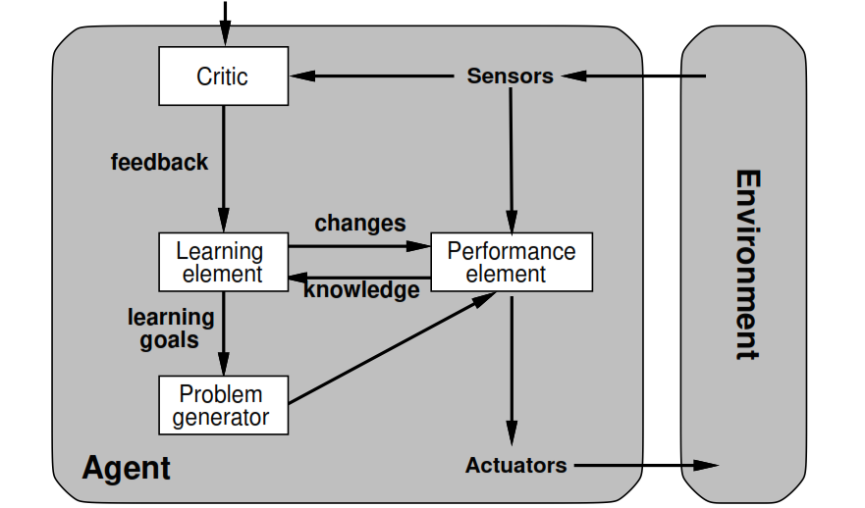
LEARNING AGENTS

